Slide 1














Airlines management system

Slide 2

Presented By
Saifulla Tanim (ID: 222002014)
Mim Akter (ID: 222002104)
Teacher by:
Umme Habiba
Lecturer
Green University of Bangladesh

Slide 3

CONTENTS
Introduction
Objectives
Features
Technology Used
Implementation Details
Challenges
Conclusion
Future Scope

Slide 4
Introduction
The Airlines Management System is a simple project built to organize and manage airline data. It uses Java for backend processing, SQL for managing the database, and HTML/PHP for the user interface. The system allows administrators to log in securely, manage airline information, and handle data easily. This project aims to offer a reliable and user-friendly solution for managing airline operations.

Slide 5
01.
Provide a secure login system for admins.
Enable easy initialisation and modification of airline information.
Objectives
02.
Create a user-friendly interface for database interaction.
03.

Slide 6
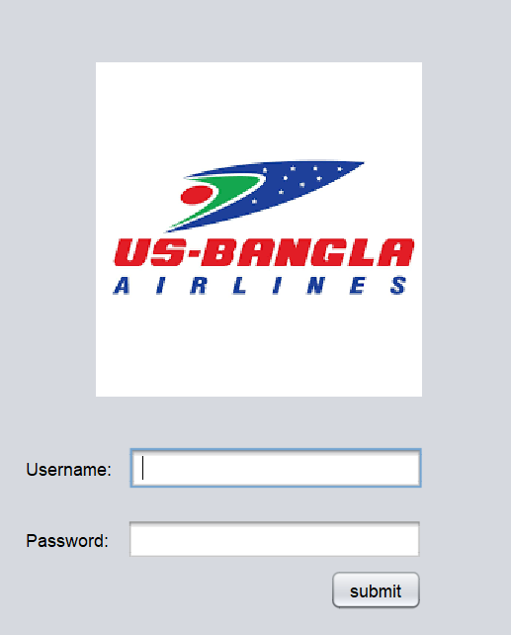

Implementation interface

Slide 7

Features
Secure Admin Login
Centralized Database Management
User-Friendly Interface
Seamless Integration with SQL

Slide 8

Future Scop
Quotation
1. Role-Based Access Control
2. Flight Scheduling and Bookings
3. Cloud Integration
4. multiple languages for a global user
5. Enhanced Security

Slide 9




Technical Challenges
Integrating Java with SQL for database operations
Development Challenges
User Interface Optimization
Ensuring a user-friendly interface while maintaining backend complexity
Challenges
Balancing a user-friendly design with the complexity of backend operations.
Integration Complexity
Difficulty in integrating Java with SQL and JAVA for seamless communication.

Slide 10
Conclusion
The Airlines Management System is a simple project that helps manage airline data easily. It uses Java, SQL, and web technologies to provide secure login and smooth data handling. This project is a great start and can be improved with more features like flight booking and cloud hosting in the future.

Slide 11
Thank you very much!

